Slide 1
ANNAMALAI UNIVERSITY DEPT OF COMMERCE
WELCOME ALL

Slide 2
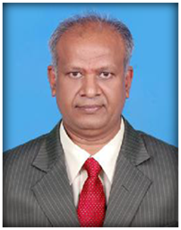
A PRESENTATION BY DR. D. ILANGOVAN, PROF & HEAD, DEPT OF COMMERCE ANNAMALAI UNIVERSITY
CORPORATE SOCIAL RESPONSIBILITY – AN INTRODUCTION

Slide 3
CSR – Corporate Social Responsibility
What it means to us:
# Seriously considering the impact of a company’s actions on society.
# Requires the individual to consider his/her acts in terms of a whole social system, and holds him/her responsible for the effects of acts anywhere in that system.

Slide 4
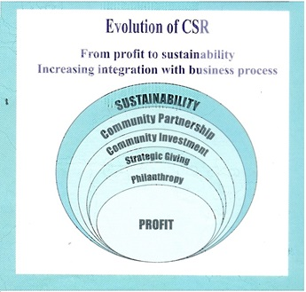

Slide 5
Selected Key Terms
0
Business for Social Responsibility
corporate social responsibility
philanthropy
community obligations
paternalism
economic responsibilities
legal responsibilities
ethical responsibilities
philanthropic responsibilities
Pyramid of CSR
corporate social responsiveness
corporate social performance (CSP)
corporate social performance model
corporate citizenship
Triple Bottom Line
sustainability
corporate sustainability
socially responsible
ethical investing

Slide 6
Corporate Citizenship Concepts
0
Corporate Social…
Emphasizes…
Responsibility
Obligation, accountability
Responsiveness
action, activity
Performance
outcomes, results

Slide 7
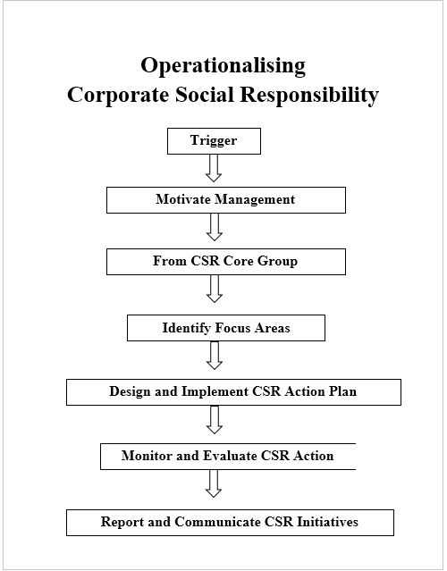

Slide 8
Business Criticism/ Social Responsibility Cycle
0
Factors in the Societal Environment
(have led to)
Criticism of Business
Increased Concern for the Social Environment
(which has resulted in)
A Changed Social Contract
Business Assumption of Corporate Social Responsibility
Social Responsiveness, Social Performance, and Corporate Citizenship
A More Satisfied Society
Fewer Factors Leading to Business Criticism
Increased Expectations Leading to More Criticism

Slide 9
Historical Perspective on CSR
0
Economic Model
Legal Model
Social Model

Slide 10
The CSR Equation
0
Economic Responsibilities
Legal Responsibilities
Ethical Responsibilities
Philanthropic Responsibilities
+
Total Corporate CSR
+
=
+

Slide 11
Modification of the Economic Model
0
Philanthropy
Community obligations
Paternalism
Motivation: Keep government at arm’s length

Slide 12
Legal Responsibilities
0
Law cannot address all the topics or issues that business may face
Law often lags behind more recent concepts of what is considered appropriate behavior
Laws are made by lawmakers and may reflect the personal interests/motivation of legislators rather than appropriate ethical justifications

Slide 13
The Pyramid of CSR
0
Philanthropic Responsibilities Be a good corporate citizen.
Ethical Responsibilities Be ethical.
Legal Responsibilities Obey the law.
Economic Responsibilities Be profitable.
Notes:
Source: Archie B. Carroll, “The Pyramid of Corporate Social Responsibility: Toward the Moral Management of Organizational Stakeholders,” Business Horizons (July-August 1981). © 1991 by the Foundation for the School of Business at Indiana University. Used with permission.

Slide 14
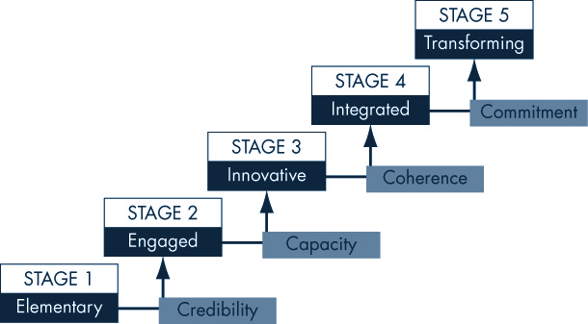
Development Challenges of Corporate Social Responsibility
0

Slide 15
Social and Financial Performance Relationship
0
Perspective 1: CSP Drives the Relationship
Good Corporate Social Performance
Good Corporate Financial Performance
Good Corporate Reputation
Perspective 2: CFP Drives the Relationship
Good Corporate Financial Performance
Good Corporate Social Performance
Good Corporate Reputation
Perspective 3: Interactive Relationship Among CSP, CFP, and CR
Good Corporate Social Performance
Good Corporate Financial Performance
Good Corporate Reputation

Slide 16
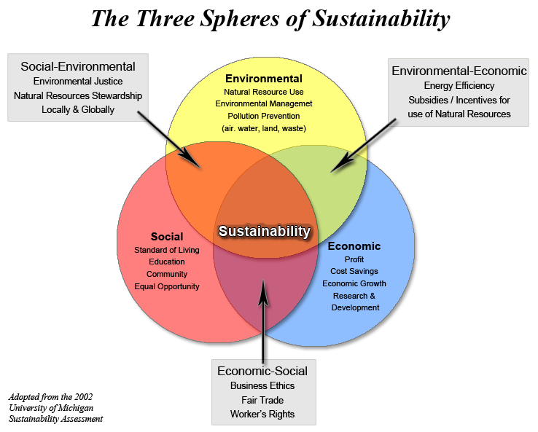

Slide 17
“Multiple Bottom Line” Perspective
0
Owner Stakeholders’ “Bottom Line”
Consumer Stakeholders’ “Bottom Line”
Corporate Social Performance
Employee Stakeholders’ “Bottom Line”
Community Stakeholders’ “Bottom Line”
Other Stakeholders’ “Bottom Line”

Slide 18
THANK YOU ALL

